Slide 1

Notes:
"Hello, fellow KDT students. I’m Byeongchae Jeong, the first presenter for Group 4.
Our team conducted this machine learning data analysis project on the theme of telemarketing success rates.
The goal of this project is to use machine learning to predict the outcome of a bank's telemarketing efforts."

Slide 2
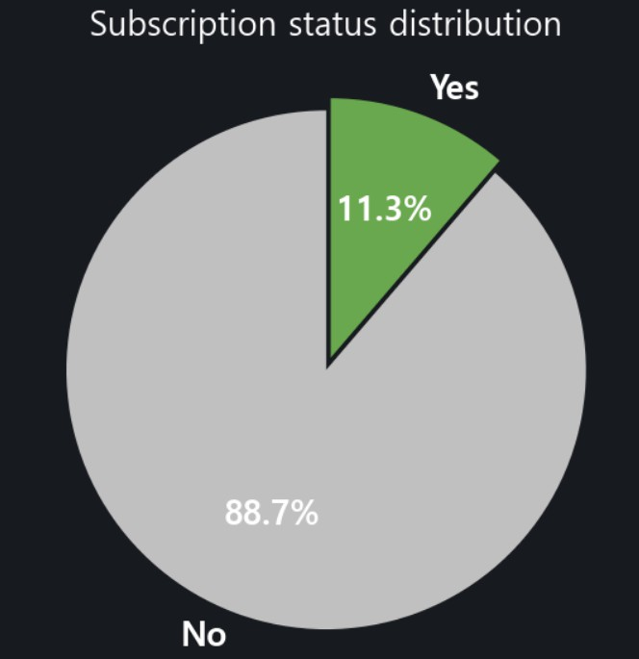





Notes:
"For this project, we analyzed data from a bank’s campaign encouraging customers to subscribe to a term deposit.
First, let’s look at the chart.
The success rate for these calls was only 11.3%.
This means 89% of the people did not subscribe.
Why couldn't they capture the hearts of that 89%?
Is it simply a lack of skill on the telemarketer's part?
My take is that a random marketing strategy naturally leads to lower success rates, which ultimately increases marketing costs.
So, how can we identify customers with a high probability of subscribing?
From now on, we will use machine learning to predict our target audience."

Slide 3












Notes:
"Let me introduce the data.
We sourced our marketing dataset from Kaggle.
It consists of 41,000 rows and 21 columns.
The columns include features like age, job, and employment rate.
On the right, you can see the class imbalance I mentioned earlier."

Slide 4

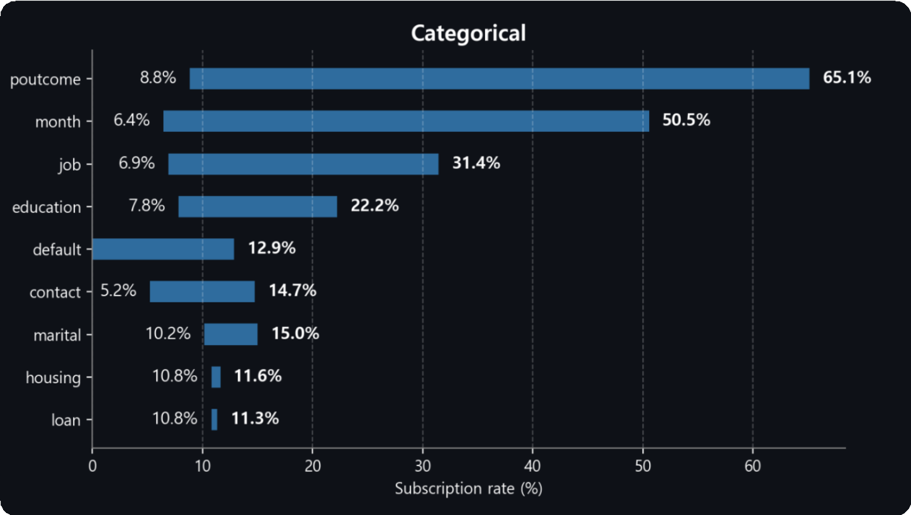
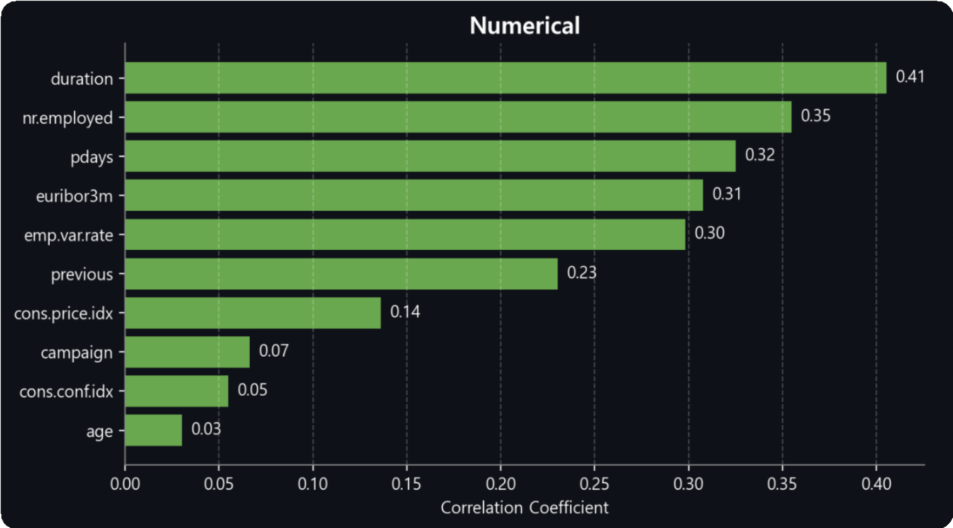
Notes:
“We performed an Exploratory Data Analysis (EDA).
First, we divided the data into categorical and numerical variables to see how each relates to the subscription status.
Since these two types are measured differently, we couldn't use a standard correlation for the categorical data on the left.
Instead, we measured the 'gap' between the overall average success rate and the success rate of specific groups within a column.
Looking at the graph, columns with a large gap between their minimum and maximum values significantly influence the success rate.
In the categorical data, 'poutcome' had the greatest impact.
On the right, we calculated the Pearson correlation for numerical data.
Here, 'duration' was the most influential variable."

Slide 5

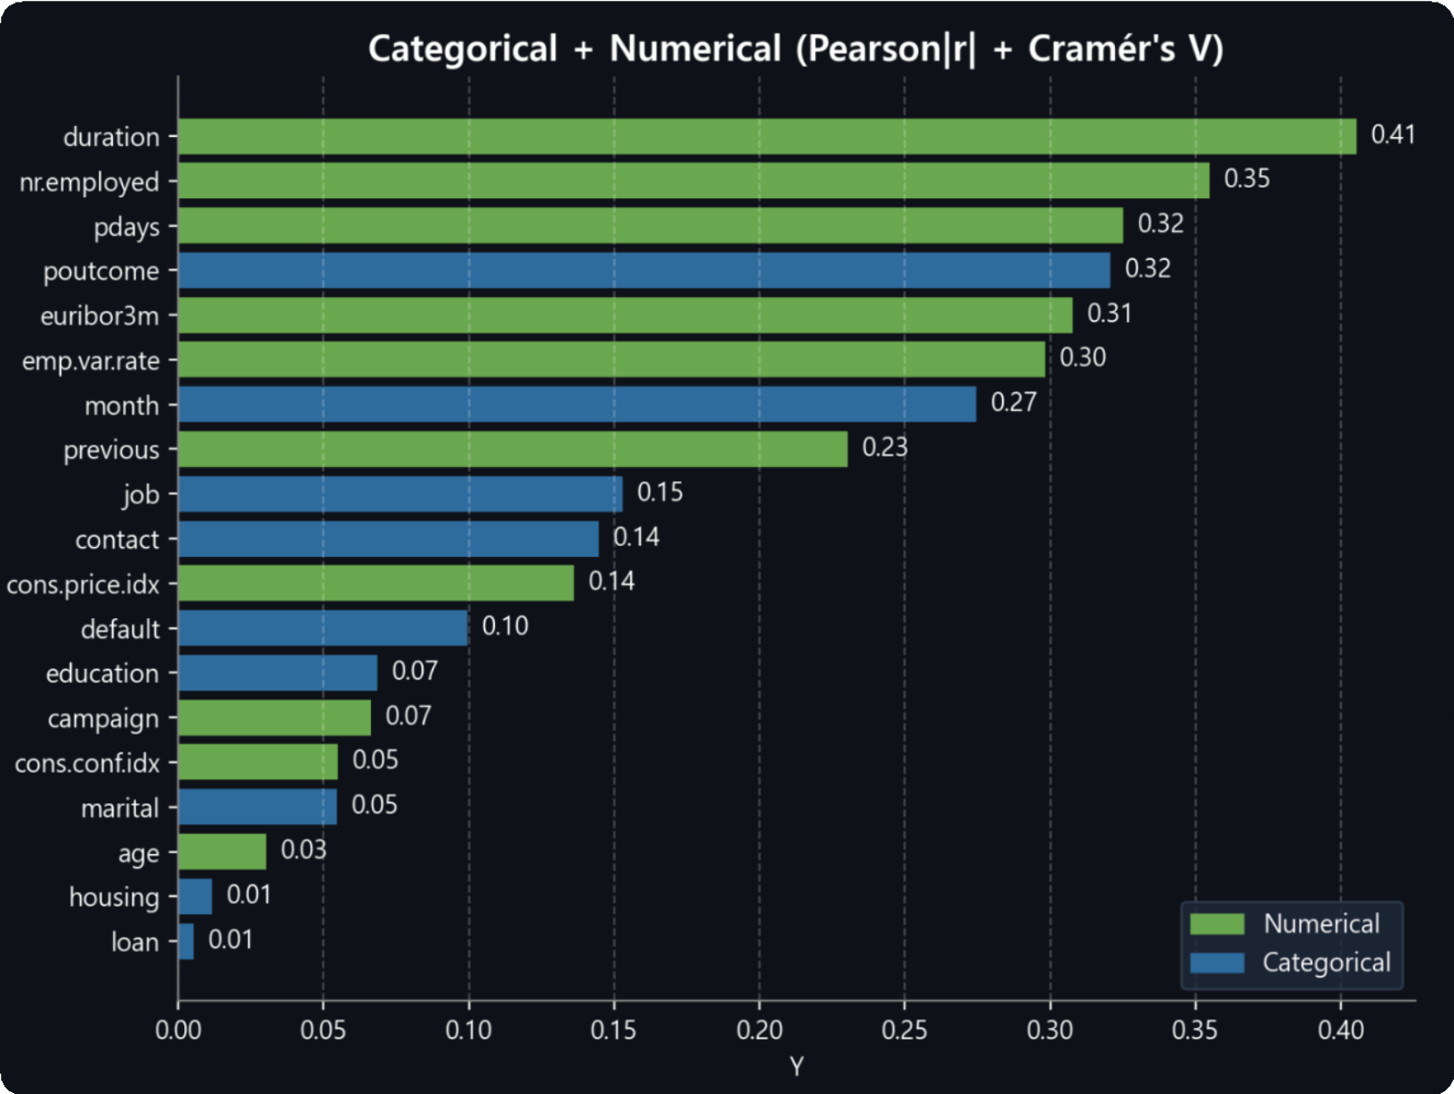
Notes:
"However, to apply this to a machine learning model, we needed a unified standard to compare categorical and numerical data.
Therefore, we applied Cramer’s V to categorical data and the absolute value of Pearson’s r to numerical data. By mapping both to a range of 0 to 1, we were able to compare them directly.
As a result, we identified the top 5 key factors influencing subscription success: duration, nr.employed, pdays, poutcome, and euribor3m.
The key takeaway here is that we succeeded in ranking the importance of variables with different characteristics by standardizing their scales.
Now, our teammate Jiha will continue with a deeper analysis of these five key features."

Slide 6

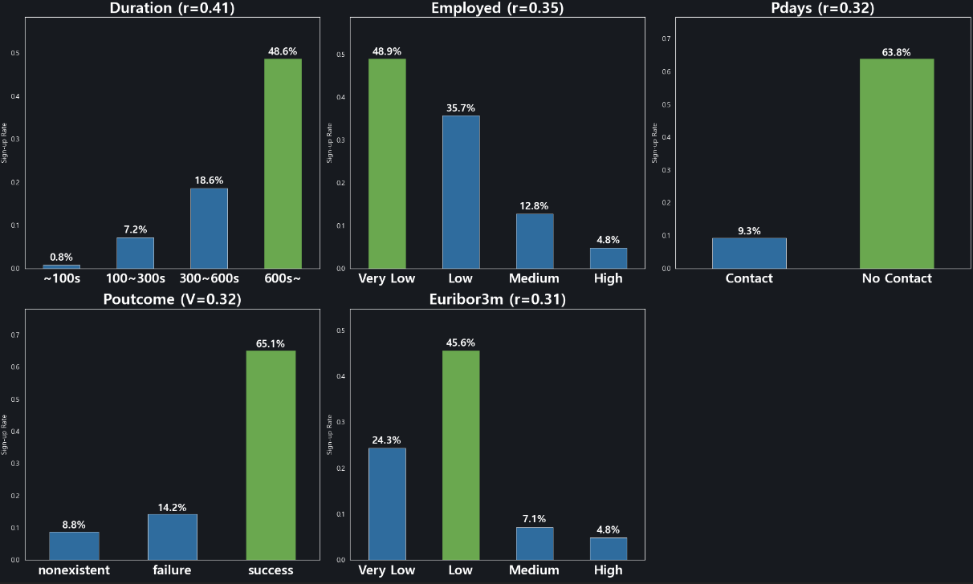
Notes:
Slide 6 shows our EDA results.
Our goal is to find which features are most related to the target Y, which is subscription, so we can understand what signals indicate a likely subscriber.
The top features were duration, employed, pdays, poutcome, and basemoney rate.
First, poutcome and pdays represent the customer’s previous campaign history.
Customers who had a successful outcome before, or customers who were contacted more recently, clearly show a higher subscription rate.
So, past response history is a very strong signal.
Next, basemoney rate and employed are macro-economic variables.
This suggests that subscription is not only about customer characteristics, but also about the overall market situation—like interest rates and employment conditions.
Finally, duration has the strongest correlation, but it is only known after the call ends.
So, if we use it directly for targeting, it can cause data leakage.
That’s why we treat duration mainly as an explanatory feature, and we use it carefully for real targeting.”

Slide 7

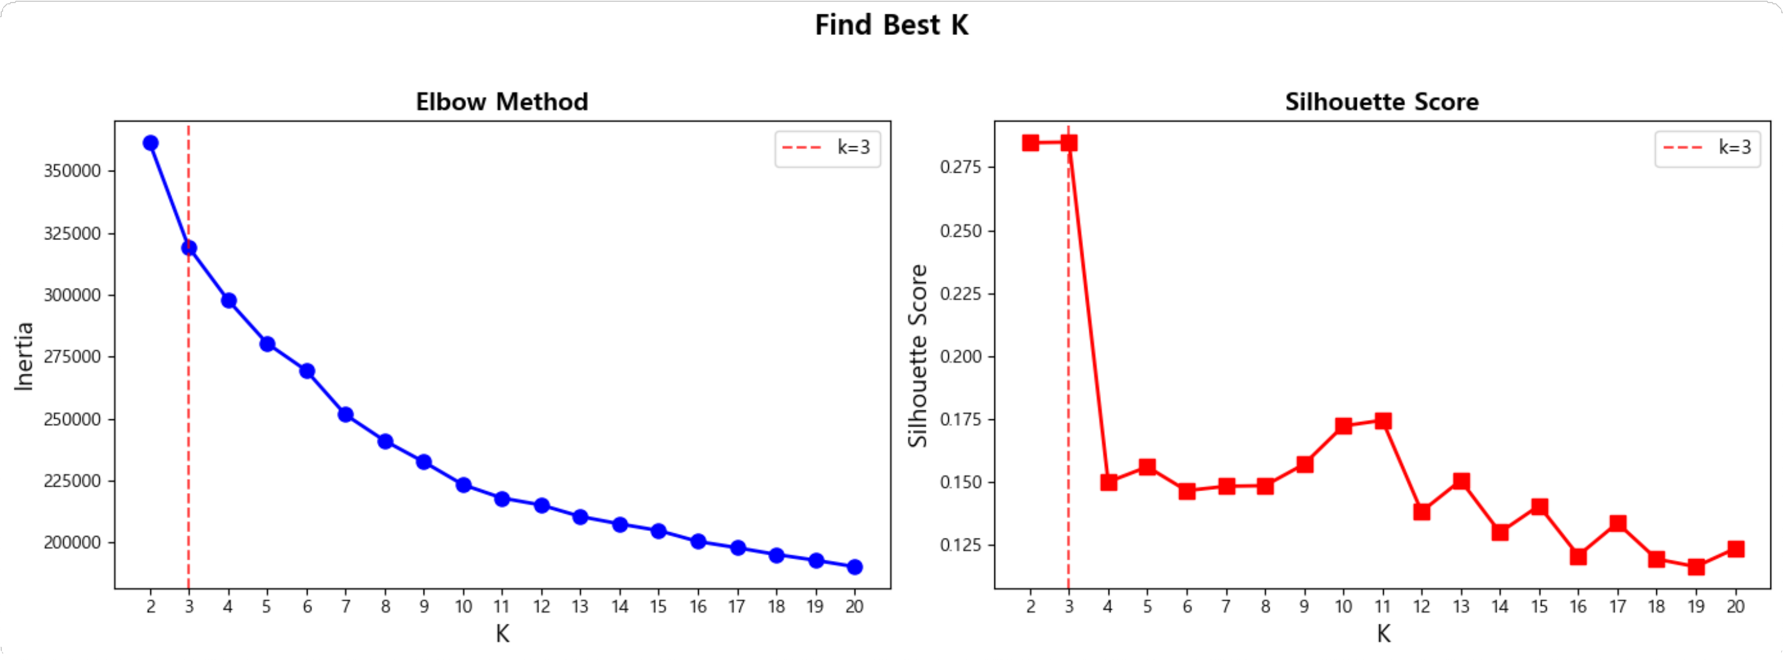

Notes:
Slide 7 is about choosing the best K for K-means clustering.
Based on the elbow method and silhouette score, K = 3 looks the best by score
However, our goal is not just the best score.
We need clusters that are interpretable and actionable for marketing.
With K = 3, the groups were too broad, so it was difficult to decide what strategy to apply to each group.
But with K = 5, the clusters were more clearly separated, and each group could be explained as a specific customer type.
So, we selected K = 5 because it works better for decision-making.

Slide 8
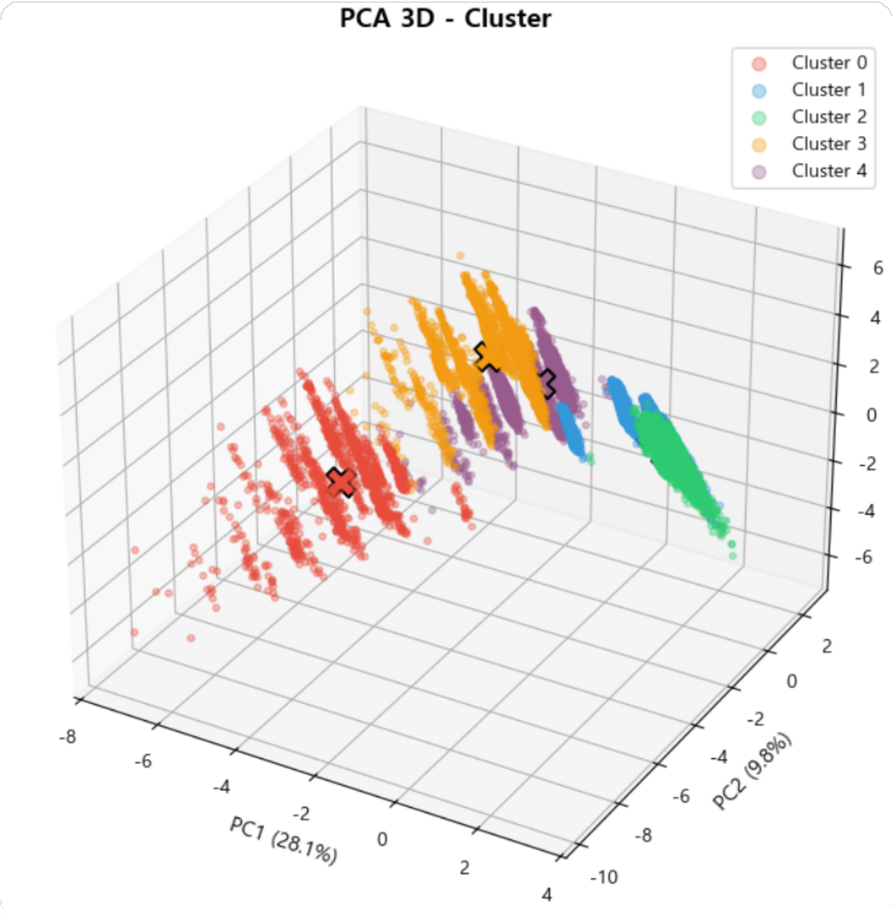
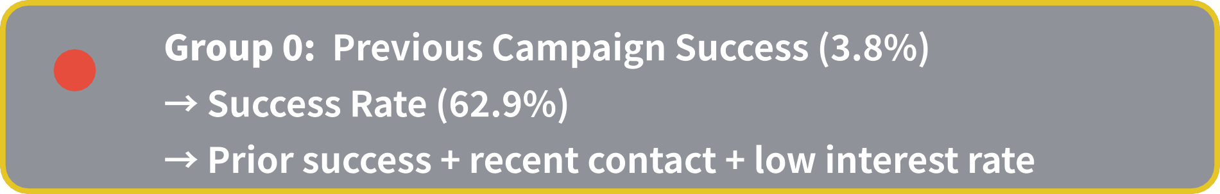




Notes:
Slide 8 explains the characteristics of each cluster when K = 5.
The key point is that each cluster shows different subscription rates and behavior patterns.
We found a small cluster with a very high subscription rate.
This group has strong positive signals like previous success and recent contact, so it becomes our top priority target with the best ROI.
Then, the mid-level clusters have moderate response rates.
For these groups, strategies like optimizing re-contact timing or improving the script can be effective.
On the other hand, the lowest-response clusters are more likely to increase cost without results.
So, for them, we should lower call priority or switch to other channels.
In summary, clustering with K = 5 helps us decide who to contact first, reduces unnecessary calls, and improves marketing efficiency.

Slide 9





Notes:
Hello everyone.
Now I will explain the supervised learning part of our project.
Our goal was to predict which customers are likely to subscribe to the bank’s marketing offer.
We tested several machine learning models and selected three main models for comparison:
Random Forest, XGBoost, and LightGBM.
First, let’s look at their performance.
Random Forest showed a recall of 66.9%.
LightGBM showed a recall of 77.8%.
And XGBoost recorded the highest recall at 83.5%.
In our project, recall is the most important metric.
This is because missing a real subscriber means losing a business opportunity.
So even if precision is lower, finding more potential subscribers is more valuable.
Based on this recall-focused evaluation, XGBoost was selected as our best predictive model.

Slide 10

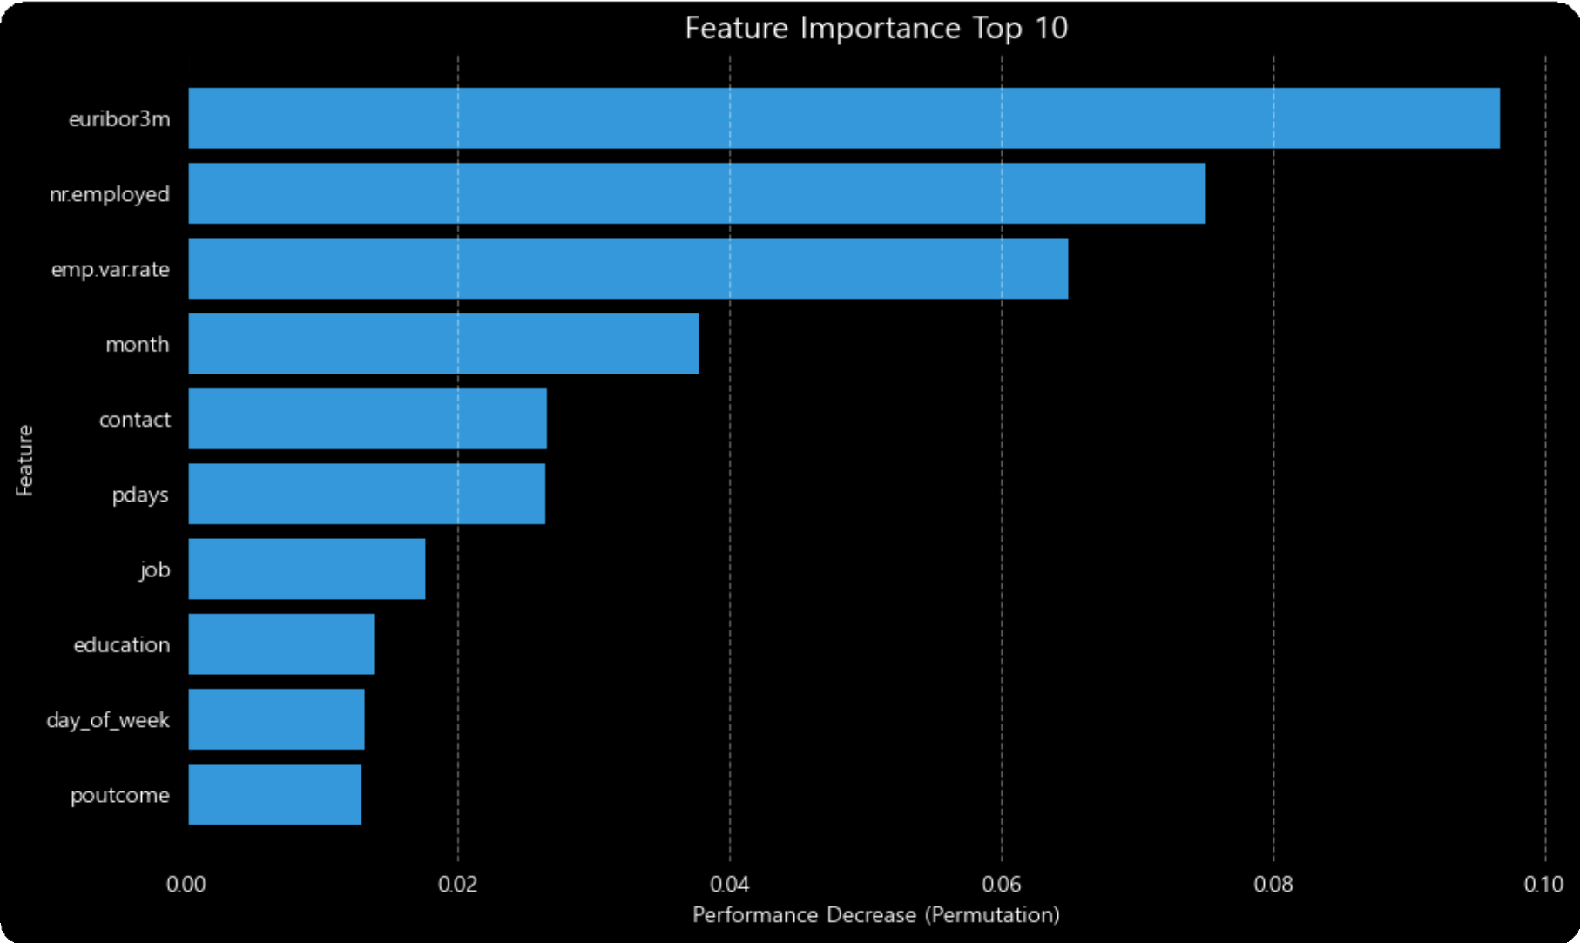
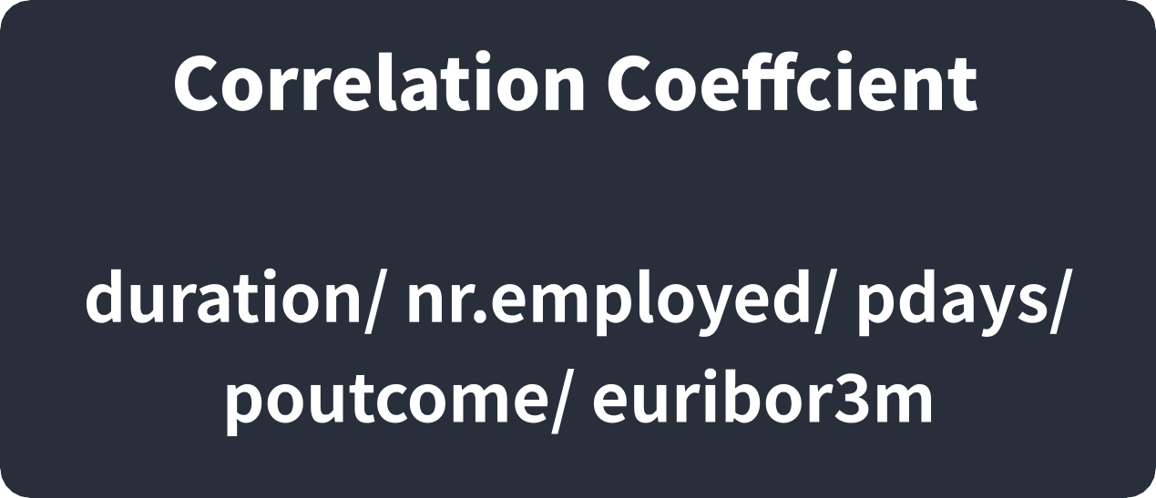
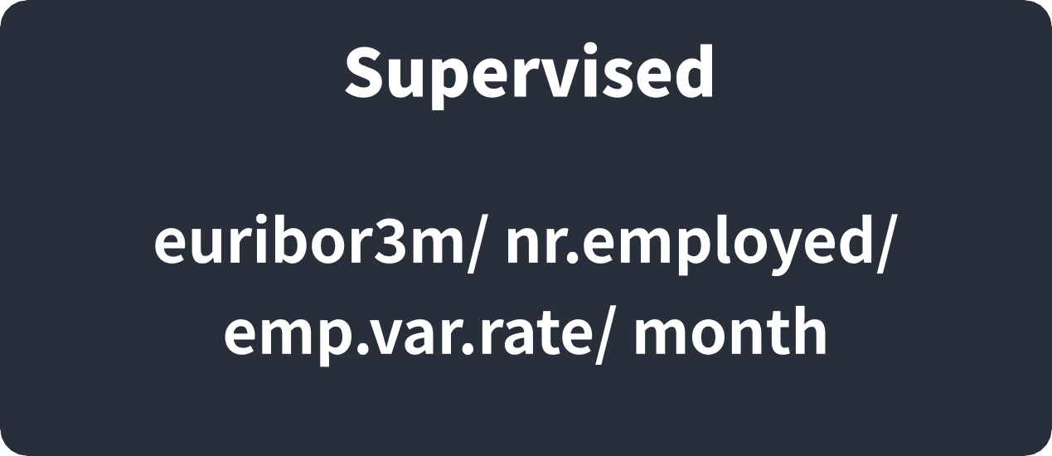
Notes:
Next, I will explain which features influenced the prediction results.
We analyzed feature importance to understand what factors affect customer subscription decisions.
The most important feature was Euribor 3-month interest rate.
This means the interest rate environment strongly affects whether customers subscribe.
When interest rates change, customers’ financial decisions also change.
The next important features were number of employees and employment variation rate.
These are economic indicators, so they show that macroeconomic conditions play a major role.
We also found that campaign factors such as contact month and contact method were important.
This tells us that when and how we contact customers matters.
Interestingly, personal information such as job or education had relatively lower importance.
This means subscription decisions are influenced more by economic conditions and marketing strategy than by personal background.
So, from this analysis, we learned that both economic timing and campaign design are key factors.
-------------------------------------------------------------------------------------------------------------------------------------------------------------------------------------------
We also compared correlation analysis with supervised learning results.
Some variables like duration, number of employees, pdays, poutcome, and euribor3m showed high correlation.
However, in supervised learning, only a few variables such as euribor3m, employment indicators, and month showed high importance.
This difference happens because correlation measures relationships between variables, while supervised learning measures impact on prediction.
So even if variables are related to each other, they may not all be useful for prediction.
This helped us identify the most practical features for real marketing use.

Slide 11








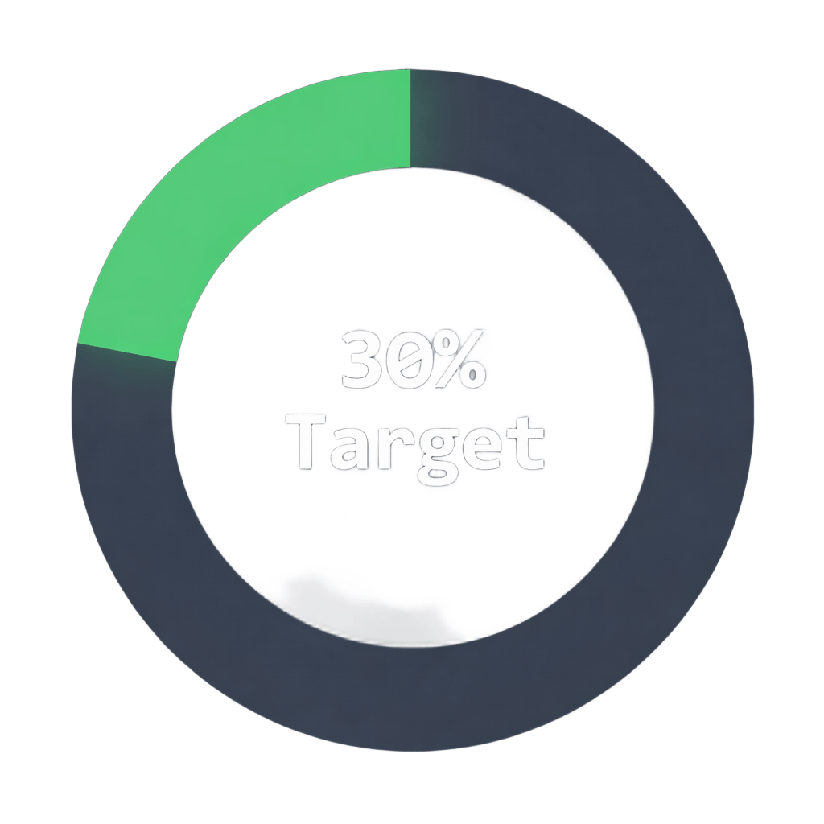
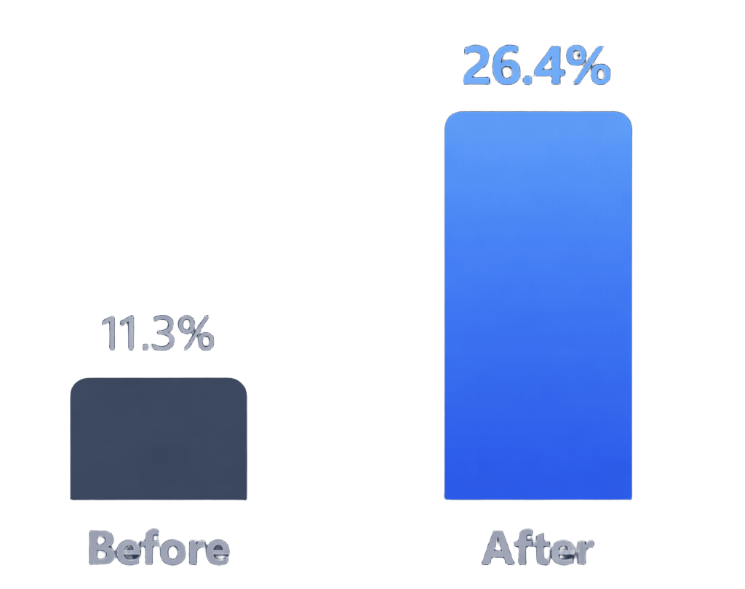
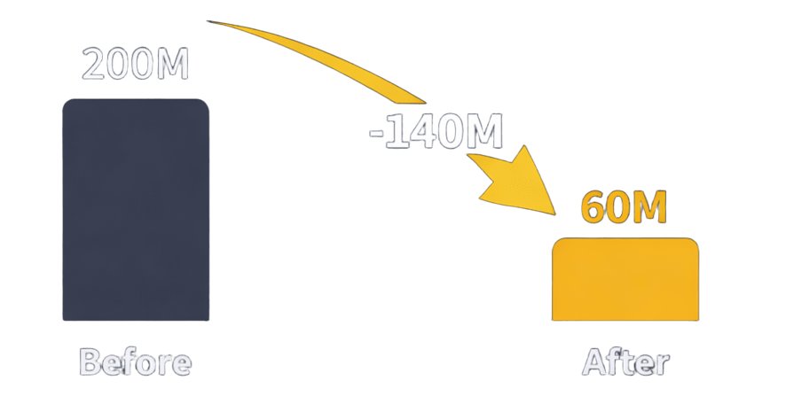



Notes:
Finally, I will explain the business impact of our model.
By applying our predictive model, we can significantly improve marketing efficiency.
First, unnecessary calls can be reduced by about 70%.
This means we contact fewer uninterested customers.
Second, marketing success rate improves from 11.3% to 26.4%.
That is about 2.3 times higher than before.
This shows that targeting the right customers increases campaign effectiveness.
Third, marketing cost can be reduced by approximately 140 million won.
As a result, overall return on investment, or ROI, is maximized.
In short, our model helps banks save cost while increasing marketing success.

Slide 12
Notes:
To summarize,
Our supervised learning model successfully predicts potential subscribers.
Economic indicators and campaign timing were the most influential factors.
By using this model, banks can improve marketing performance, reduce cost, and make smarter decisions.
Thank you for listening.

